Slide 1
Have Your Say Exploratory Data Analysis
Hubert Ruczyński
Stanisław Łaniewski
Stanisław Giziński

Slide 2
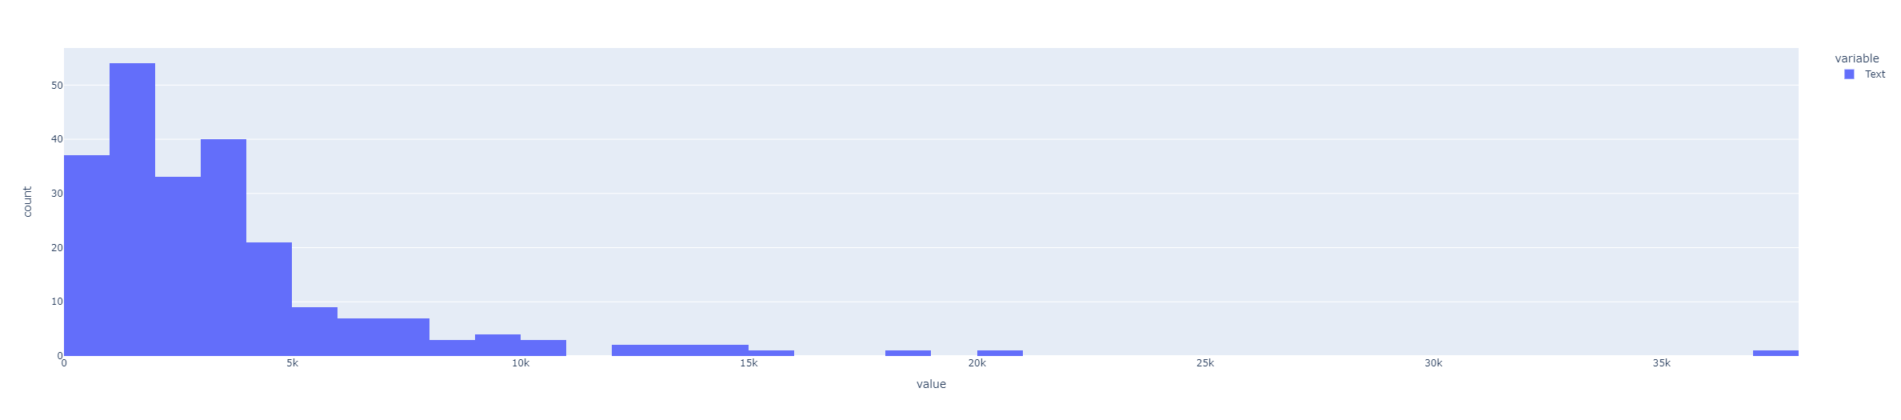
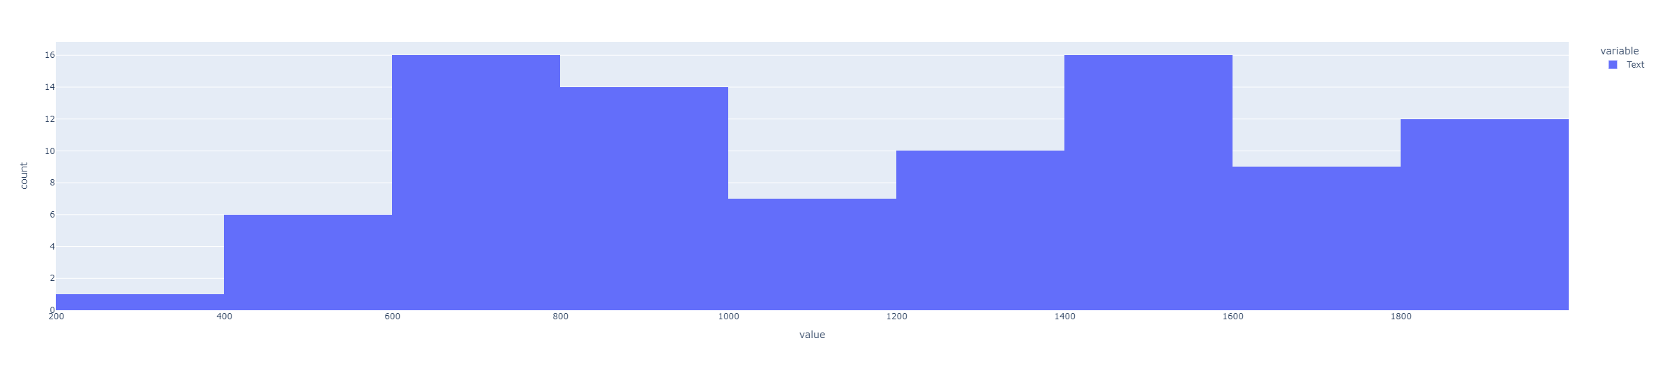
About Dataset

Slide 3
Cleaning from obvious topics keywords
'ai','systems','regulation','datum','data','use','article','european','act','eu','commission','proposal','include','intelligence','artificial','technology','application','ensure','approach','propose','need','user','assessment','authority','definition','law','legal','impact','protection','development','consider','rules', 'authorities', 'applications', 'standards', 'technologies', ’bodies’, 'plan','requirements', 'providers', 'provide', 'shall', 'draft', 'europe', 'propose'

Slide 4
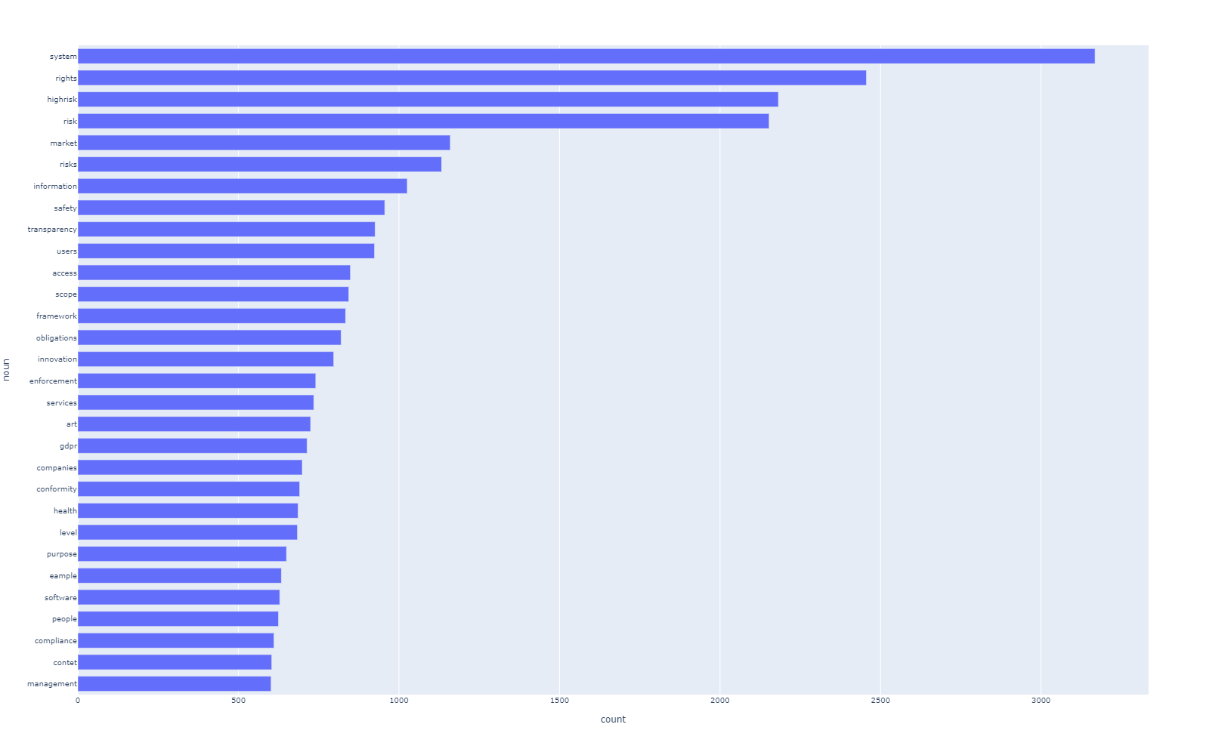
Most common nouns

Slide 5
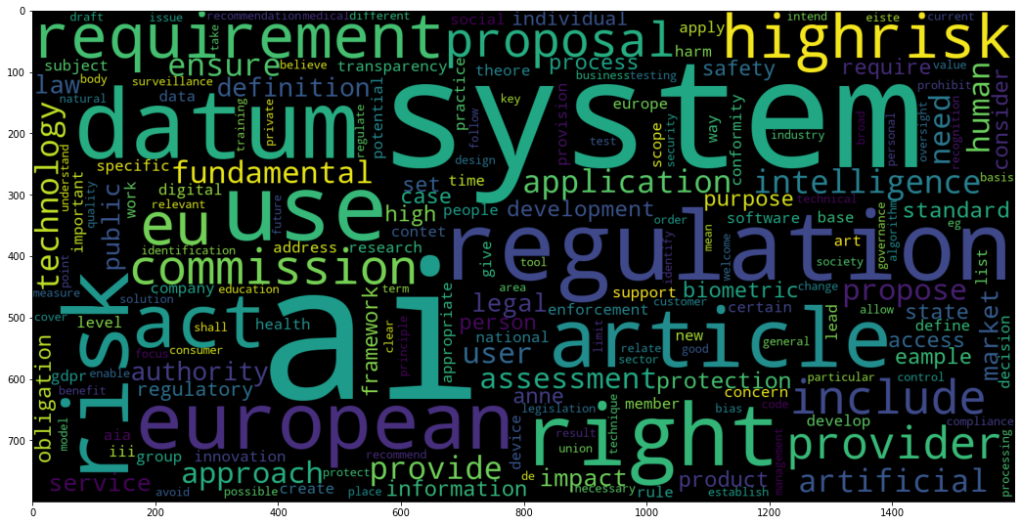
Wordcloud

Slide 6
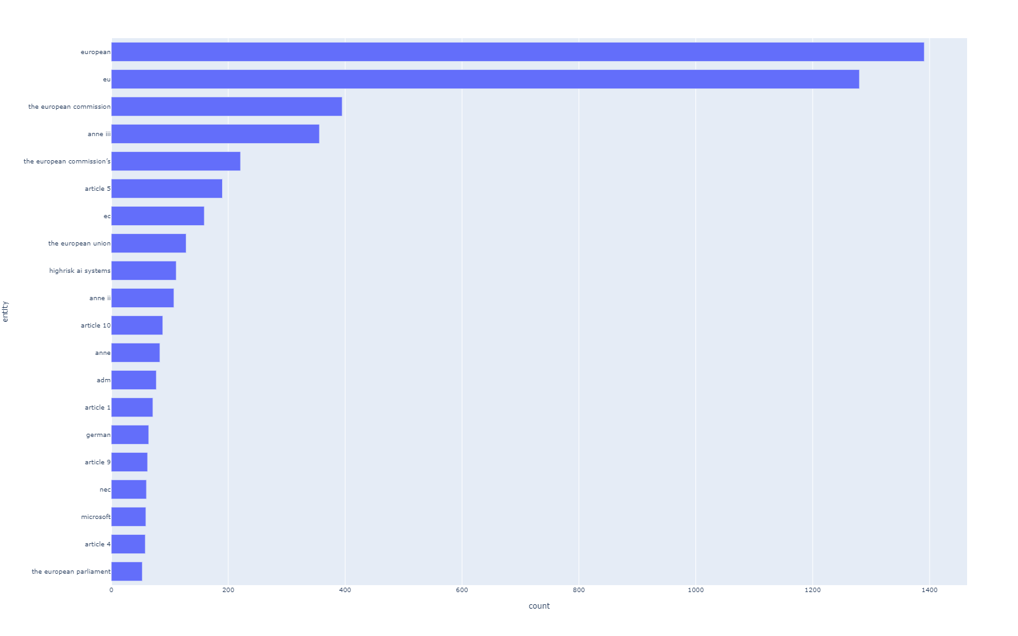
Named entities

Slide 7
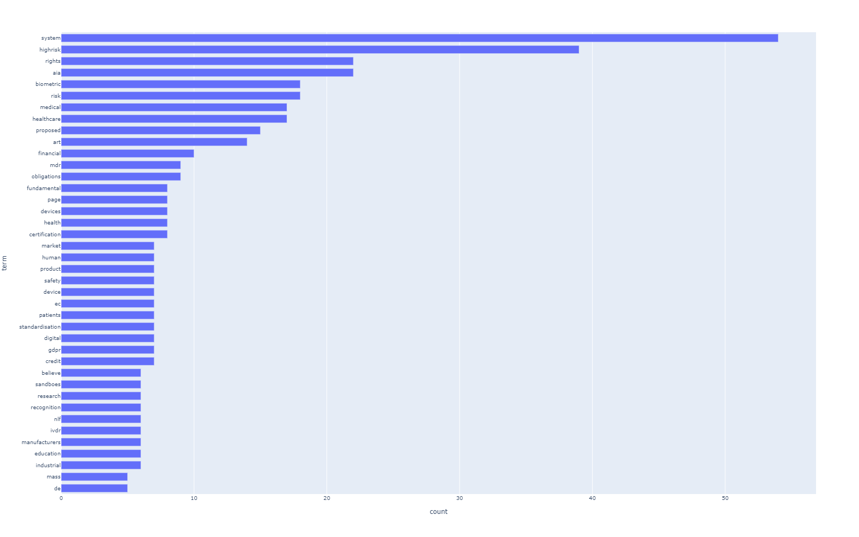
Tf-idf occurences

Slide 8
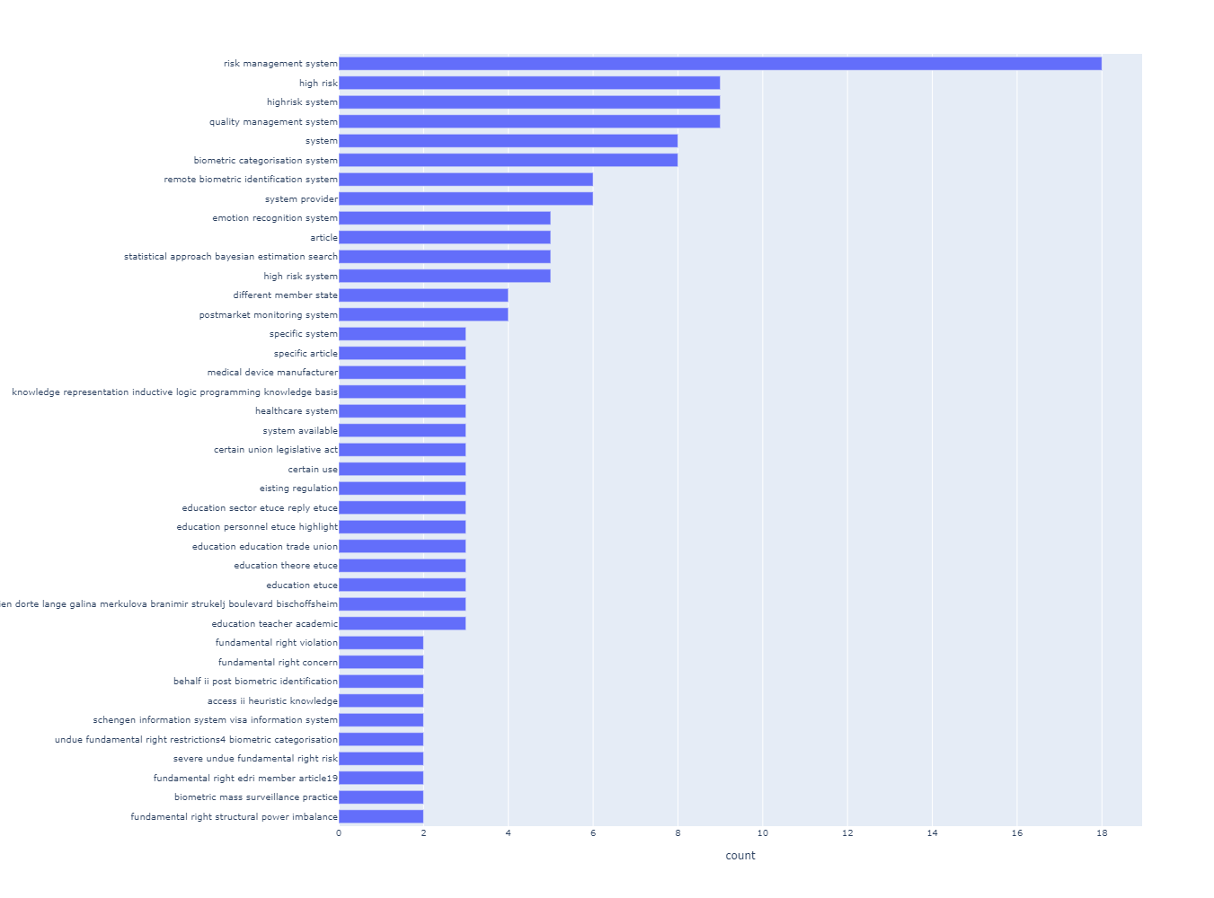
Keyterms / Textrank

Slide 9
Noun chunks

Slide 10
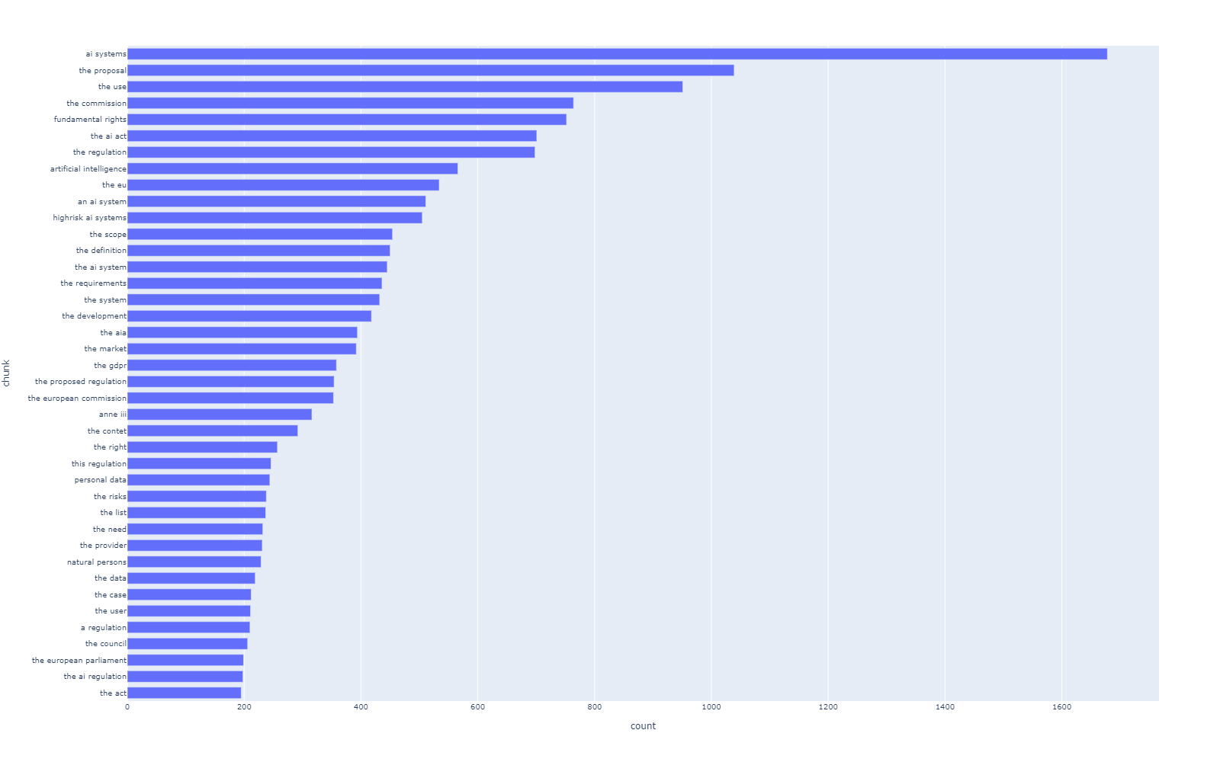
Noun chunks with stop words

Slide 11
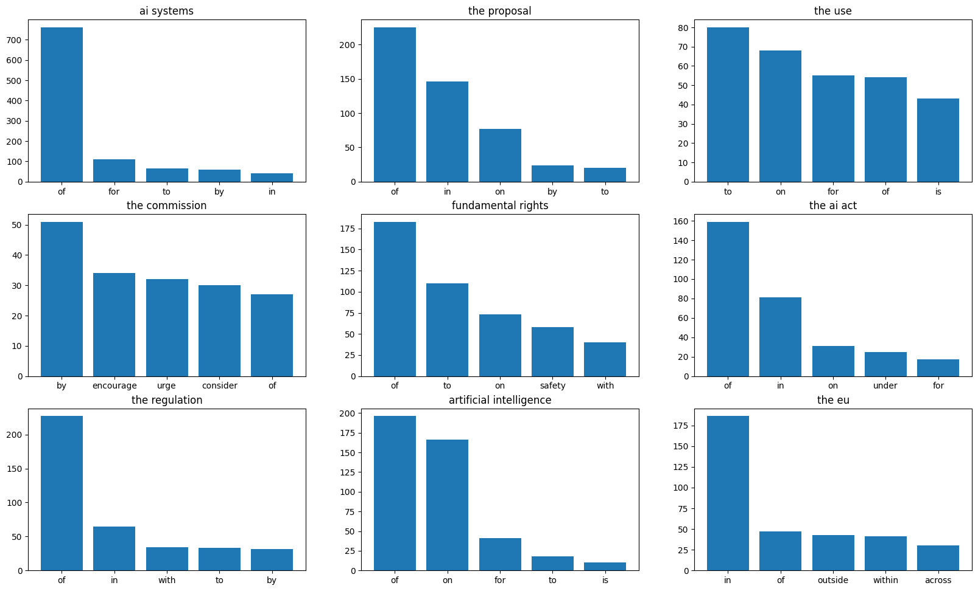
Parents of noun chunks with stop words

Slide 12
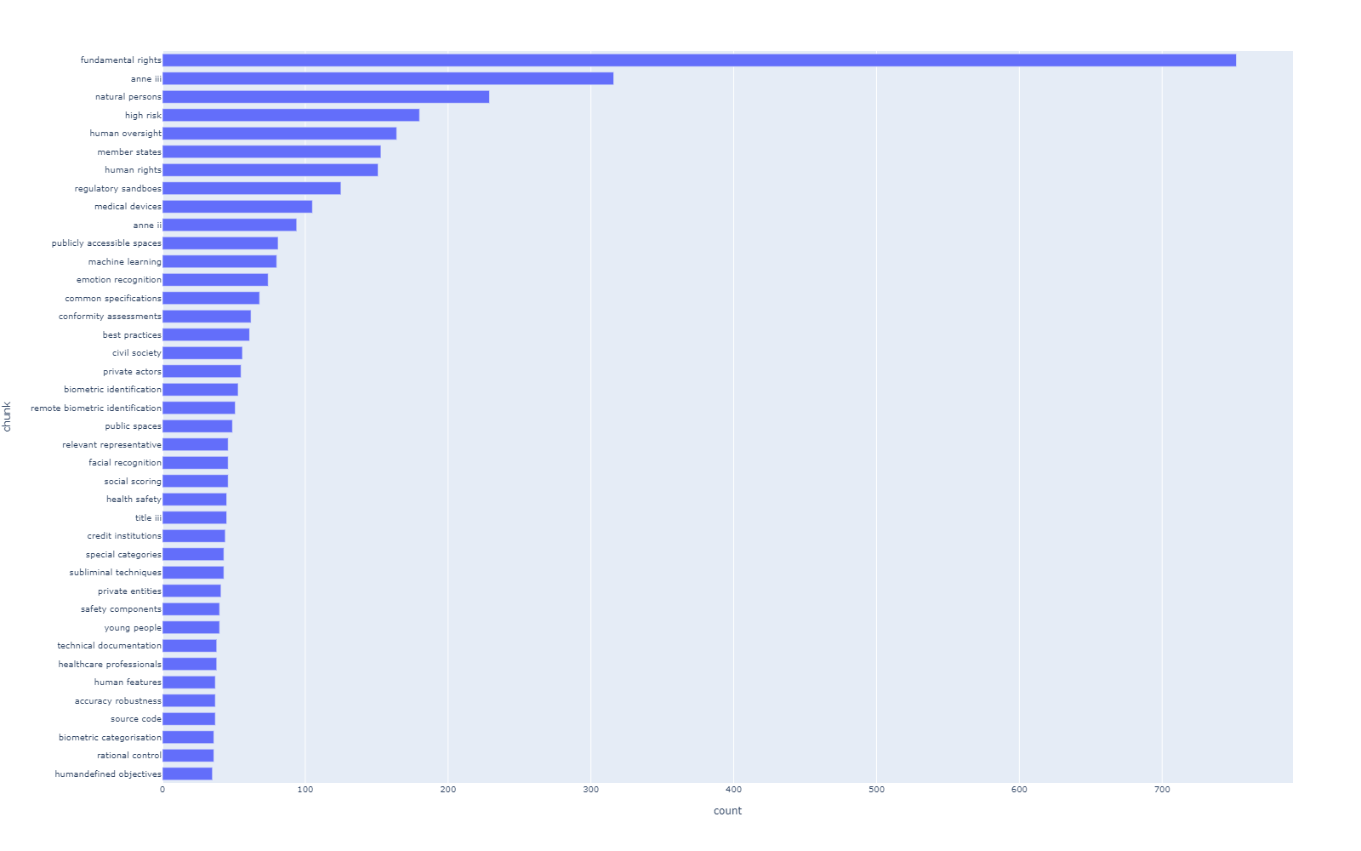
Noun chunks without stop words

Slide 13
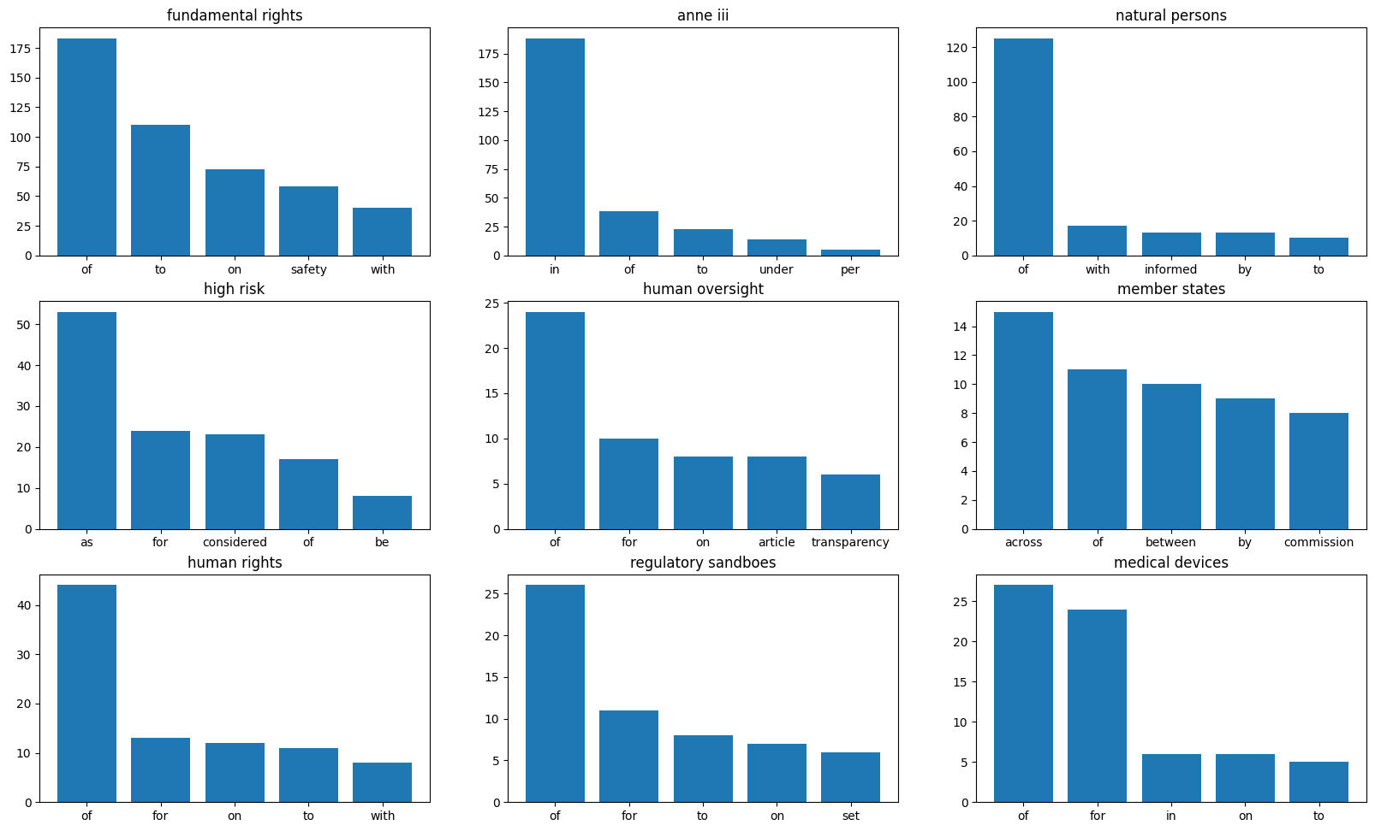
Parents of noun chunks without stop words

Slide 14
Noun chunks comparison

Slide 15
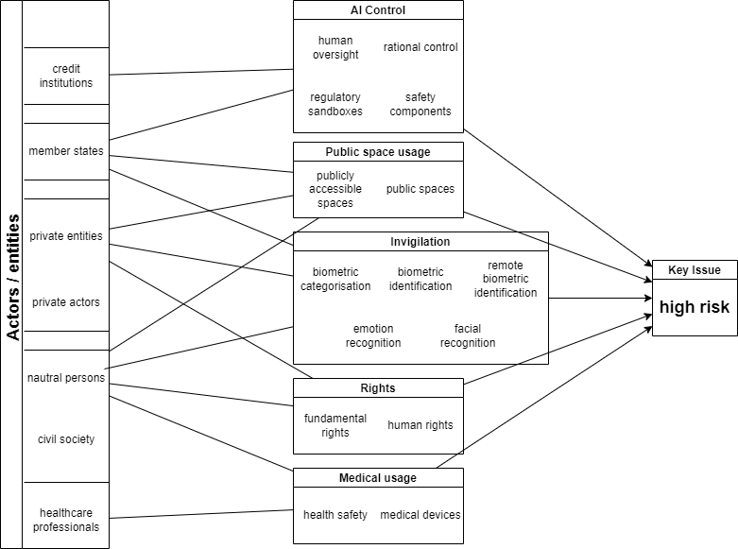
Manual Topic Analysis

